Slide 1
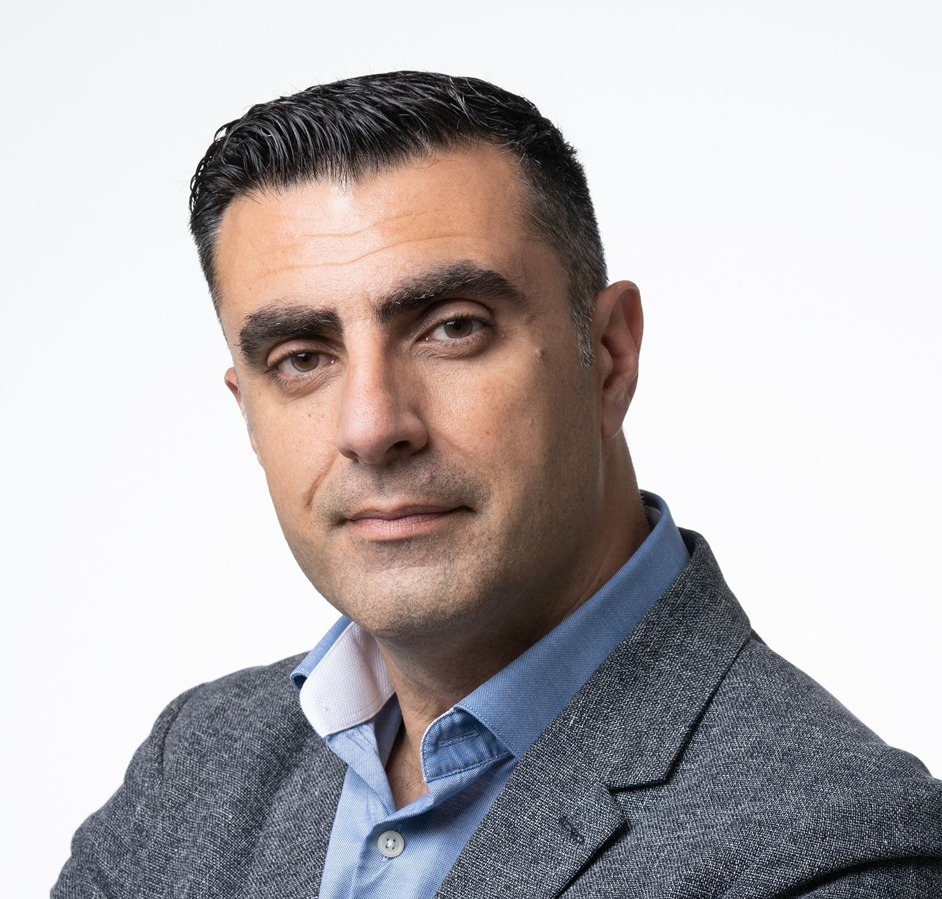
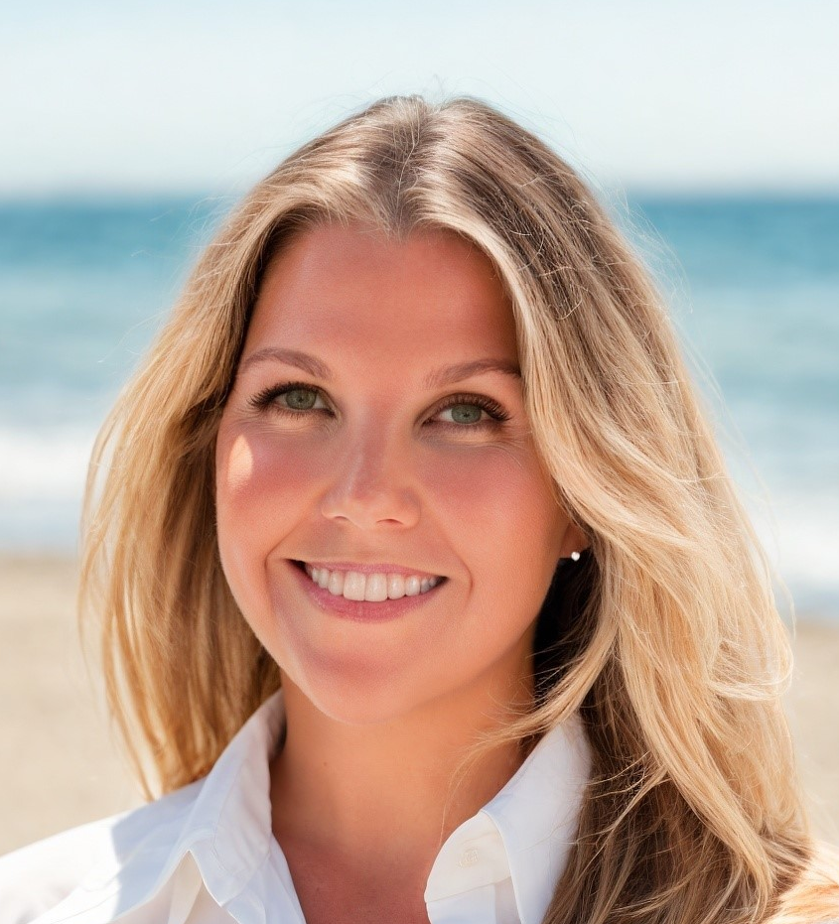
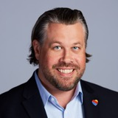
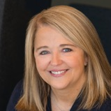
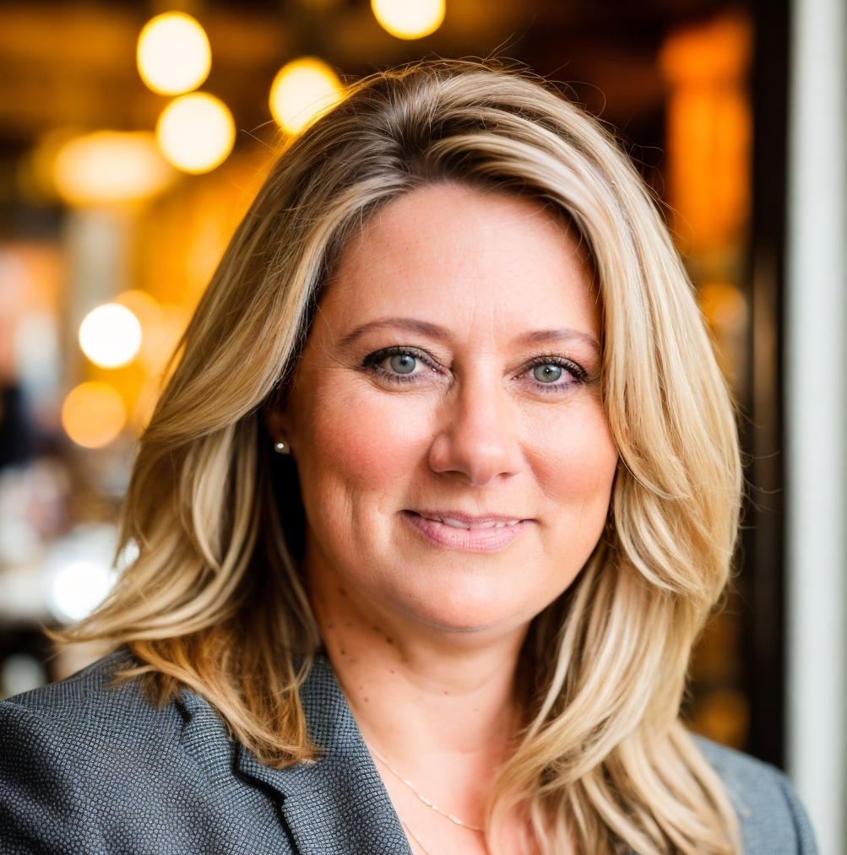
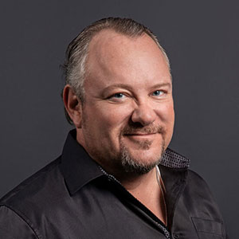
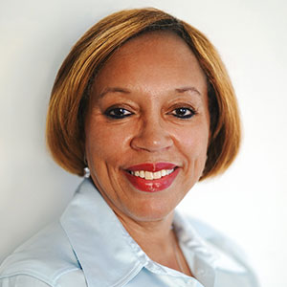
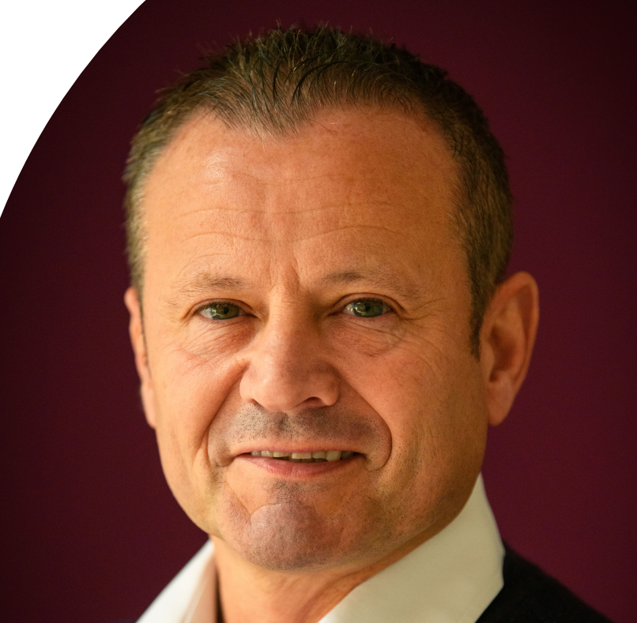
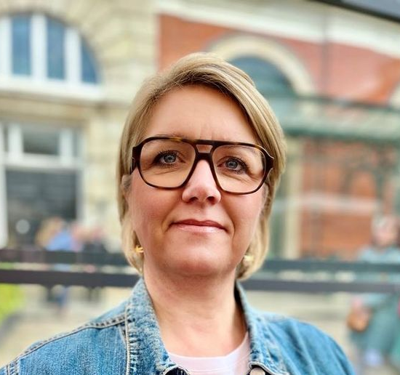
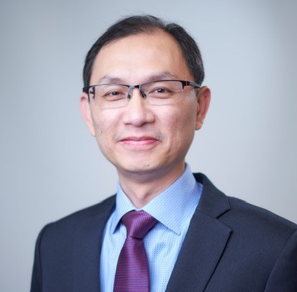
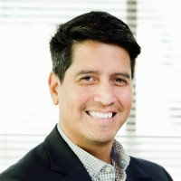
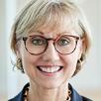
GBTA Board of Directors 2024 - 2025
Mark Cuschieri
President, GBTA
Executive Director
Global Head of Travel
UBS
Rosemary Maloney
Vice President, GBTA
Senior Director, Corporate Travel The Freeman Company
Kevin Sullivan
Treasurer, GBTA
Managing Director of Sales (Global, National, Analytics, Customer Success)
Southwest Business
Tammy Routh
President, Allied Leadership Council, GBTA
Senior Vice President Global Sales Organization Marriott International
Ronda Dean
CPC President, GBTA
US Travel Manager
F5 , Inc.
Mike Daly
Allied Seat, At Large,
SVP
Serko
Carol Fergus
Direct Seat, At Large, GBTA
Director, Global Travel Events and Ground Transportation
Fidelity International
Elizabeth (Liz) Oliveira, GTP
Direct Seat, Regional Canada, GBTA
Global Travel Manager
OMERS
Carlos Almendros
Direct Seat, At Large, GBTA
Senior Global Travel, Card & Meetings Manager
Cisco Systems
Paulina Möller
Direct Seat, At Large, GBTA
Global Travel Leader
IKEA
Ben Park
Direct Seat, Regional Europe, GBTA
Executive Director Travel & Sustainability
Parexel
Katharine Farrell
Allied Seat, At Large, GBTA
Manager, Sales Marketing Digital Comms
Delta
Peter Koh
Ex-Officio Member,
APAC, GBTA
Felipe Cardona
Ex-Officio Member,
LATAM, GBTA
Suzanne Neufang
CEO, GBTA
Ex-officio Member
Katie Virtue
Allied Seat, At Large, GBTA
Head of Sales and Marketing
Festive Road

